Slide 1

Sixth Edition
Chapter 7
The Experimental Research Strategy

Slide 2
Cause-and-Effect Relationships
What is the goal of the experimental research strategy?
  To establish the existence of a cause-and-effect relationship between two variables
Experiment (true experiment)
  Must demonstrate that changes in one variable are directly responsible for causing changes in the second variable

Slide 3
Four Basic Elements of Experiments
Manipulation
  Researcher manipulates one variable by changing its value to create a set of two or more treatment conditions.
Measurement
  A second variable is measured for a group of participants resulting in a set of scores in each treatment condition.
Comparison
  The scores in one treatment condition are compared with the scores in another treatment condition.
Control
  All other variables are controlled to be sure that they do not influence the two variables being examined.

Slide 4
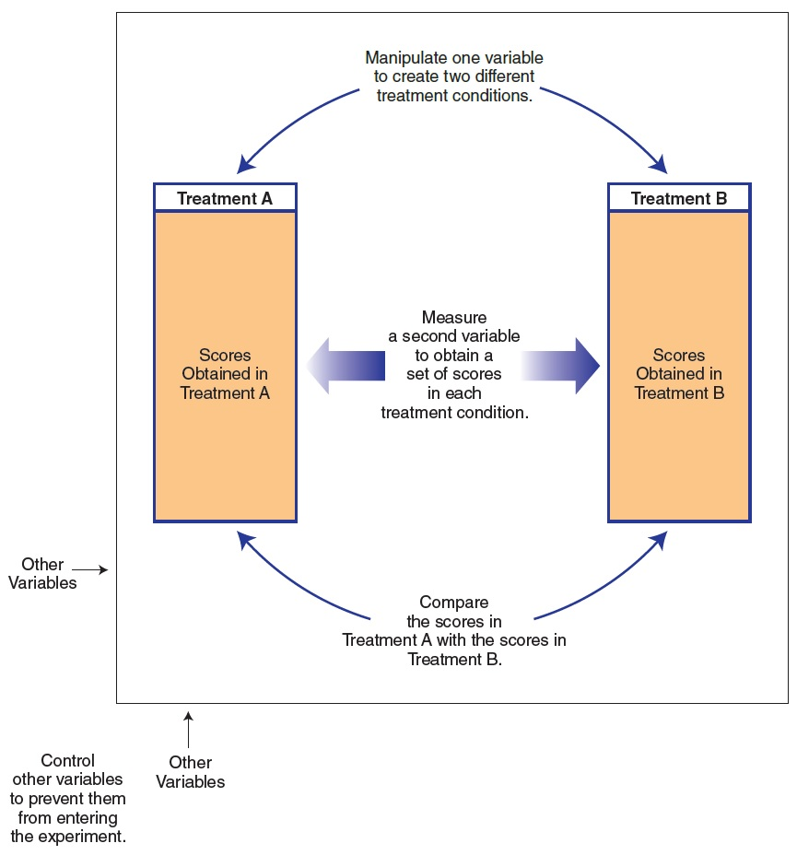
Notes:
Figure 7.1 The Basic Components of an Experimental Research Study

Slide 5
Terminology for the Experimental Research Strategy (1 of 2)
Independent variable (IV): the variable that is manipulated by the researcher
  By creating a set of treatment conditions
Treatment condition: a situation or environment characterized by:
  One specific value of the manipulated variable
Levels: different values of the IV
  Selected to create and define the treatment conditions

Slide 6
Terminology for the Experimental Research Strategy (2 of 2)
Dependent variable (DV): the variable that is observed for changes to assess the effects of manipulating the IV
Extraneous variables: all other variables in the study other than the IVs and DVs

Slide 7
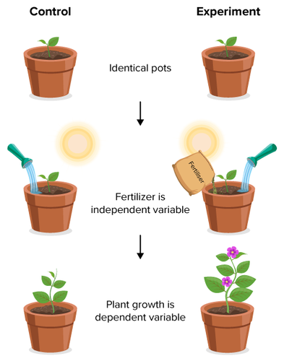
Example

Slide 8
Causation and the Third-Variable Problem
The third-variable problem: a study may establish that two variables are related.
  It does not necessarily mean that there is a direct (causal) relationship.
    A third (unidentified) variable may be responsible for producing the observed relationship.

Slide 9
Causation and the Directionality Problem
Directionality problem: a research study may establish a relationship between two variables.
  The existence of a relationship does not always explain the direction of the relationship.
    The remaining problem is to determine which variable is the cause and which is the effect.

Slide 10
Controlling Nature
An experiment must control nature to establish a cause-and-effect relationship.
  The two variables being examined must be isolated from the influence of other variables.
    The exact character of a relationship must be clear.

Slide 11
Distinguishing Elements of an Experiment
Basic goals in demonstrating a cause-and-effect relationship
  Demonstrate that the “cause” happens before the “effect” occurs
    Value of the IV is followed by a change in the DV.
  Establish that one specific variable is responsible for changes in another variable
    An experiment must rule out the possibility that changes are caused by an extraneous variable.

Slide 12
Manipulation
Manipulation consists of:
  determining the specific values of the independent variable to be examined
  creating a set of treatment conditions corresponding to that set of identified values

Slide 13
Manipulation and the Directionality Problem (1 of 2)
Manipulation allows researchers to determine the direction of the relationship.
  Manipulate one variable (IV) and observe the second variable (DV) to see if it is affected
    Researcher determines specific values of the IV to examine.
    How does changing the IV affect the DV?

Slide 14
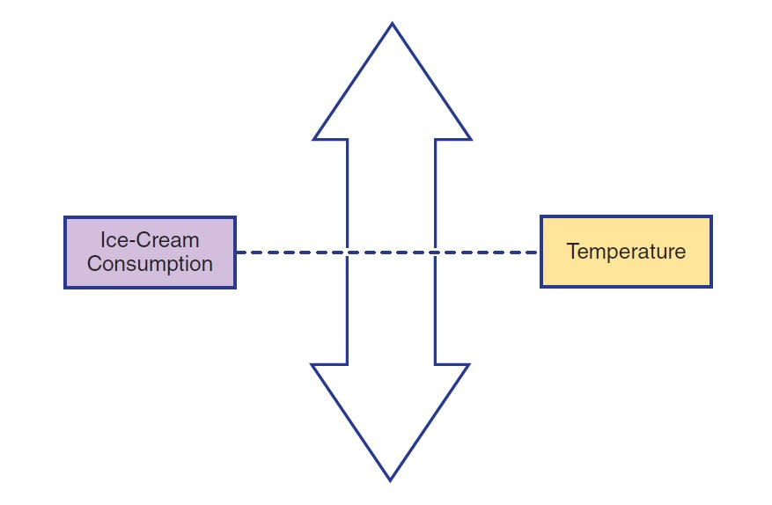
Manipulation and the Directionality Problem (2 of 2)
Notes:
Figure 7.2 Using Manipulation to Determine the Direction of a Cause-and-Effect Relationship

Slide 15
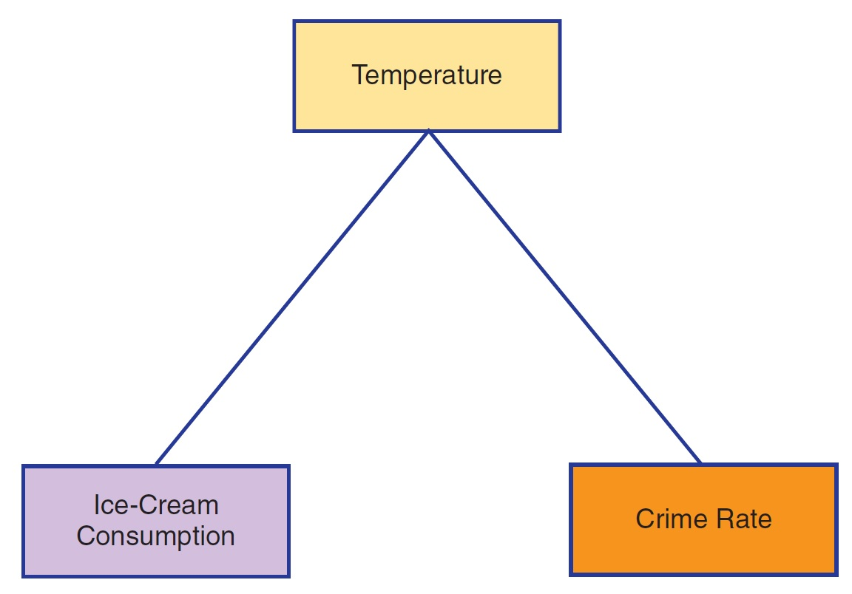
Manipulation and the Third-Variable Problem
Manipulation can also be used to control the influence of outside variables.

Slide 16
Control and the Third-Variable Problem
Control of other variables (other than the IV and DV)
  Observed relationship must not be contaminated by the influence of other variables.
Researcher must eliminate all confounding variables.
  A third variable that changes systematically along with the two variables being studied

Slide 17
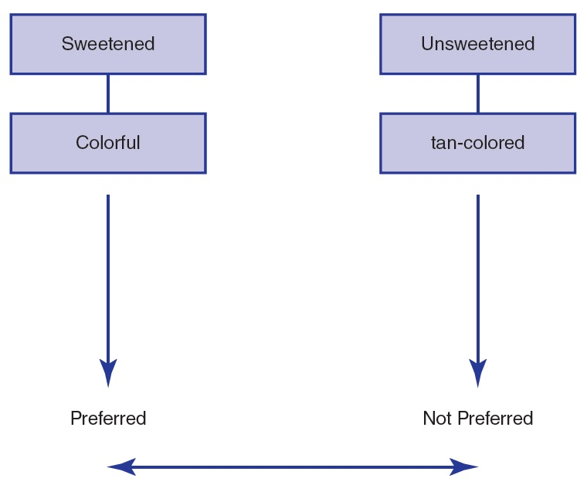
Confounding Variables
Notes:
Figure 7.4 Confounding Variables

Slide 18
Extraneous Variables and Confounding Variables
An extraneous variable becomes a confounding variable only if it influences the DV.
  Something totally unrelated to the DV is not a threat.
A confounding variable must vary systematically with the IV.
  A variable that changes randomly, with no relation to the IV, is not a threat.

Slide 19
Controlling Extraneous Variables
What are the three primary techniques for controlling extraneous variables?
  Holding variables constant
  Matching values across treatment conditions
  Control by randomization
    Uses a random process to help avoid a systematic relationship between two variables
    A powerful tool for controlling extraneous variables

Slide 20
Comparing Methods of Control
Goal of an experiment
  Show that differences in the dependent variable are caused by the independent variable
    Note: the purpose of control is to ensure that no variable could be responsible for causing the scores to differ.

Slide 21
Advantages and Disadvantages of Control Methods
Holding constant and matching
  Require extra effort or extra measurement
  Holding constant also limits external validity
Randomization
  Controls a wide variety of variables simultaneously
  Is not guaranteed to be successful in balancing variables

Slide 22
Control Groups and Manipulation Checks
Experimental condition refers to the treatment condition in an experiment.
Control condition refers to the no-treatment condition in an experiment.
Why is it important to have a control group?

Slide 23
Control Conditions (1 of 2)
No-treatment control condition
  A condition in an experiment in which the participants do not receive the treatment being evaluated
Placebo control condition
  An ineffective treatment that has no medicinal effect
  The “placebo effect” occurs simply because the individual thinks the medication is effective.

Slide 24
Control Conditions (2 of 2)
The importance of the placebo effect depends on the type of research.
  Outcome research investigates the effectiveness of a treatment.
    Goal is to determine whether a treatment produces a substantial or clinically significant effect.
  Process research attempts to identify the active components of the treatment.
    The placebo effect must be separated from other active components of the treatment.

Slide 25
Manipulation Checks (1 of 2)
Directly measure whether the IV had the intended effect on the participant
Ways to check the manipulation
  Explicitly measure the IV
  Ask specific questions about the manipulation in a questionnaire completed by participants after the experiment

Slide 26
Manipulation Checks (2 of 2)
Particularly important in four situations:
  Participant manipulations
  Subtle manipulations
  Simulations
  Placebo controls

Slide 27
Increasing External Validity: Simulation and Field Studies
Simulation: the creation of conditions within an experiment that closely duplicate the natural environment for a behavior
  Mundane realism
  Experimental realism
Field study: research conducted in a place that the participant or subject perceives as a natural environment

Slide 28
Advantages and Disadvantages of Simulation and Field Studies
Advantages: allow researchers to investigate more lifelike situations
Disadvantages: allow nature to intrude, reduce the amount of control, risk compromising internal validity

